Slide 1
CMP262 Final Project
Thiago Schuck

Slide 2
Introduction
What are the best selling products
Benefactors
Employees
Entrepreneurs
Customers

Slide 3
Methodology
Walmart API -> CSV file
Names, prices, sales, availability, reviews of products
Jupyter notebook, BlueCart API, matplotlib, pandas

Slide 4
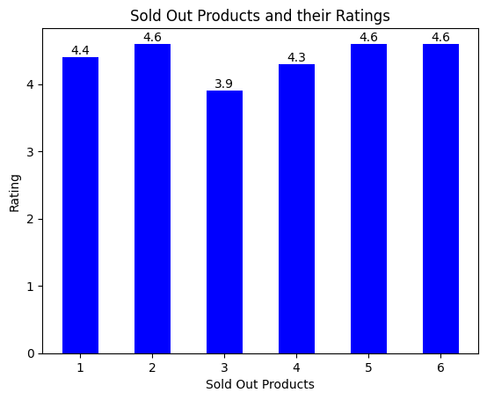
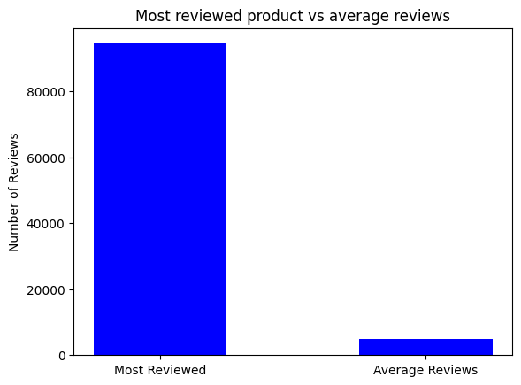
Results
Most purchased products:
Clothing, electronics

Slide 5
Future Work
Data constantly updating
More pages
Most profit

